Slide 1
Washington State SASQUATCH Reading Award 2013
CONTEST RULES
READ 2 of the 12 books (or have them read to you)
VOTE for you favorite one in late March

Slide 2
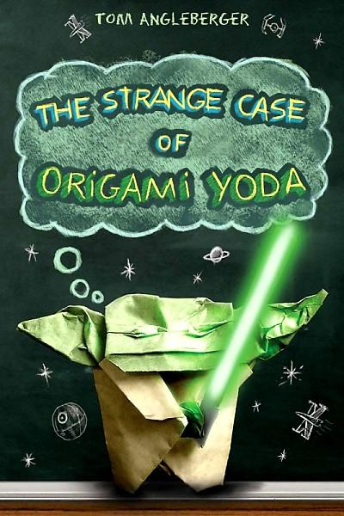
The Strange Case of Origami Yoda by Tom Angleberger
Sixth-grader Tommy and his friends describe their interactions with a paper finger puppet of Yoda, worn by their weird classmate Dwight, as they try to figure out whether or not the puppet can really predict the future. Includes instructions for making Origami Yoda.
AR Level 4.7

Slide 3
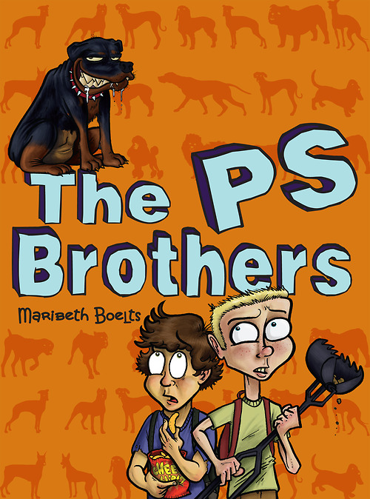
The PS Brothers by Maribeth Boelts
Sixth-graders Russell and Shawn, poor and picked on, work together scooping dog droppings to earn money for a Rottweiler puppy to protect them from bullies, but when they learn the puppies' owner is running an illegal dog-fighting ring, they are torn about how to respond.
AR Level 4.8

Slide 4
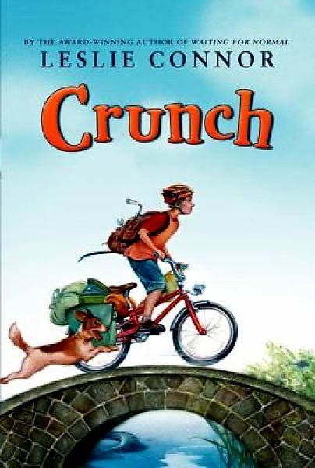
Crunch by Leslie Connor
The oldest Mariss brother, fourteen-year-old Dewey, attempts to be the "embodiment of responsibility" as he juggles the management of the family's bicycle repair business while sharing the household and farm duties with his siblings after a sudden energy crisis strands their parents far from home.
AR Level 3.3

Slide 5
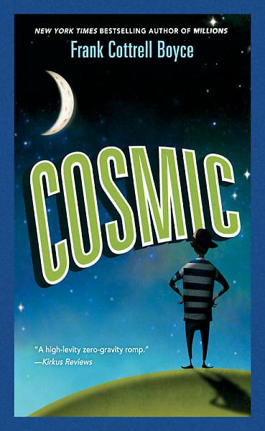
Cosmic by Frank Cottrell Boyce
Twelve-year-old Liam, who looks like he is thirty and is tired of being treated like he is older than he actually is, decides he is going to pose as the adult chaperone on the first spaceship to take civilians into space, but when he ends up in outer space with a group of kids and no adult supervision, he must think fast to make things right.
AR Level 4.5

Slide 6
Out of My Mind by Sharon Draper
Considered by many to be mentally retarded, a brilliant, impatient fifth-grader with cerebral palsy discovers a technological device that will allow her to speak for the first time.
AR Level 4.3

Slide 7
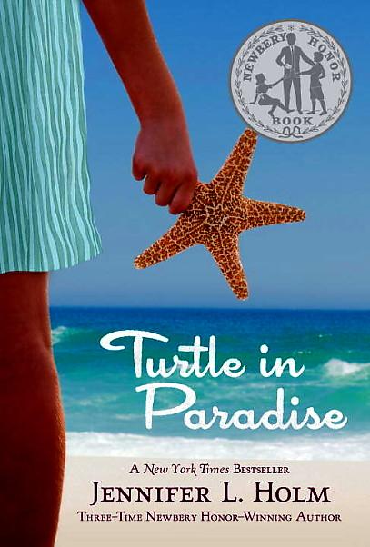
Turtle in Paradise by Jennifer Holm
In 1935, when her mother gets a job housekeeping for a woman who does not like children, eleven-year-old Turtle is sent to stay with relatives she has never met in far away Key West, Florida.
AR Level 3.7

Slide 8
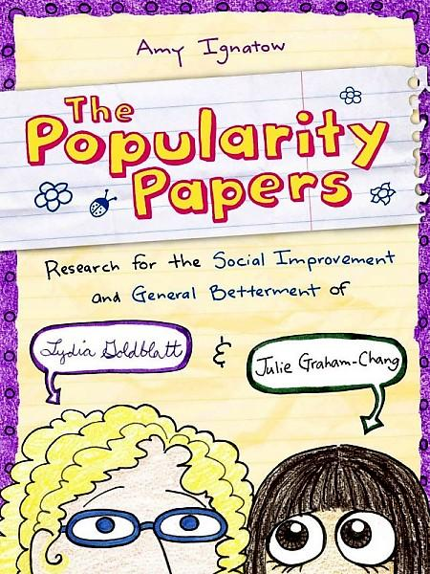
The Popularity Papers: Research for the Social Improvement and General Betterment of Lydia Goldblatt & Julie Graham-Chang by Amy Ignatow
Two best friends embark on a project to study the behavior and taste of the popular girls at their elementary school, so that by the time they get to middle school they too will be in the right crowd. They record their findings in the form of a scrapbook.
AR Level 4.0

Slide 9
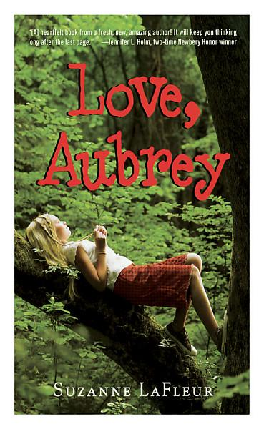
Love, Aubrey by Suzanne LaFleur
While living with her Gram in Vermont, eleven-year-old Aubrey writes letters as a way of dealing with losing her father and sister in a car accident, and then being abandoned by her grief-stricken mother.
AR Level 3.7

Slide 10
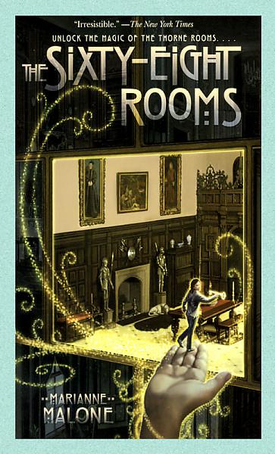
The Sixty-Eight Rooms by Marianne Malone
An adventure about the Thorne Rooms, sixty-eight miniature rooms made by Mrs. James Ward Thorne in the 1930s, and a magic key that allows a person to shrink down small enough to explore the rooms' secrets.
AR Level 5.2

Slide 11
A Long Walk to Water by Linda Sue Park
When the Sudanese civil war reaches his village in 1985, eleven-year-old Salva becomes separated from his family and must walk with other Dinka tribe members through southern Sudan, Ethiopia, and Kenya in search of safe haven. Based on the life of Salva Dut, who, after emigrating to America in 1996, began a project to dig water wells in Sudan.
AR Level 5.0

Slide 12
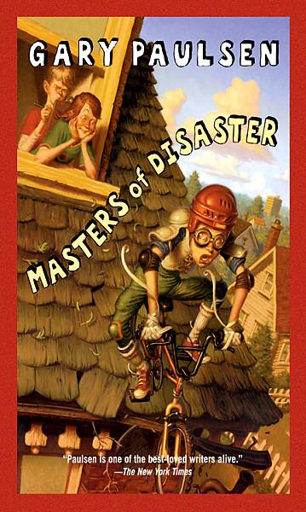
Masters of Disaster by Gary Paulsen
Twelve-year-old Henry Mosely, having decided his life is boring, ropes his friends Riley and Reed into a series of hair-raising adventures, including trying to break world records, visiting a haunted house, and solving a century-old murder.
AR Level 6.5

Slide 13
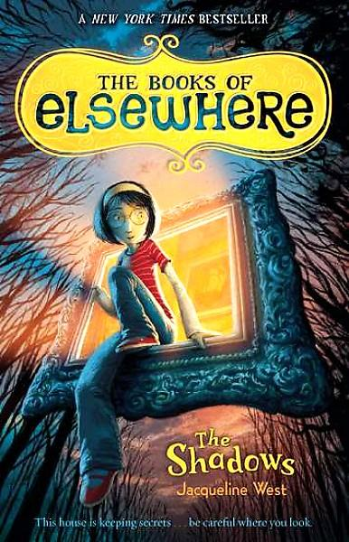
The Books of Elsewhere: The Shadows by Jacqueline West
When eleven-year-old Olive and her distracted parents move into an old Victorian mansion, Olive finds herself ensnared in a dark plan involving some mysterious paintings, a trapped and angry nine-year-old boy, and three talking cats. Book #1
AR Level 5.1

